Slide 1
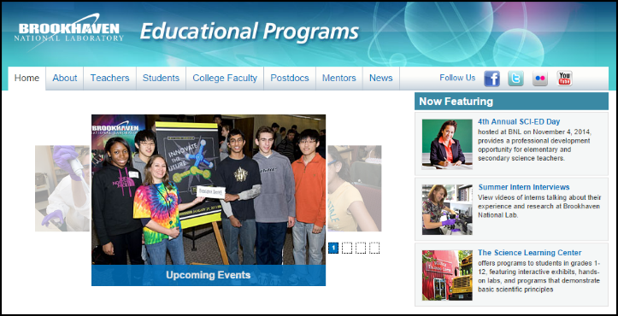
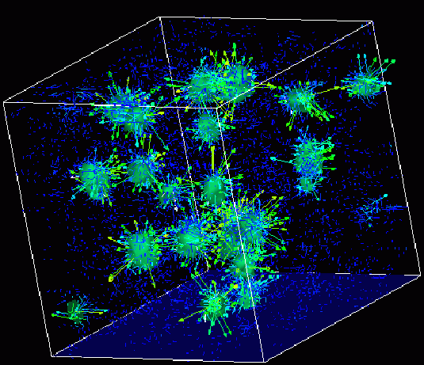
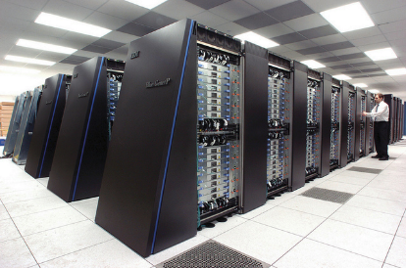
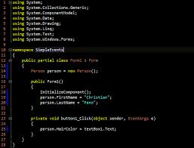
Survey of
Scientific Computing
(SciComp 301)
Dave Biersach
Brookhaven National Laboratory
dbiersach@bnl.gov
Session 06
Statistics,
Euler Line

Slide 2
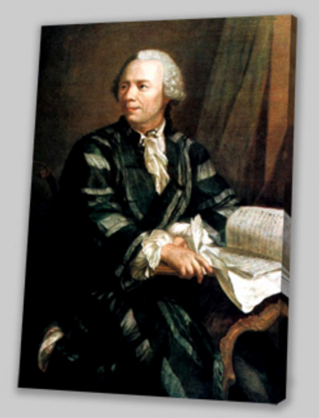
Session Goals
Generate Hero ability scores in role-playing games
Create and call functions in C++
Calculate the mean, variance, and standard deviation of a sequence of numbers
How to request “random” integers within a given range
Develop a computational mathematics experiment that uncovers a magic number hidden in all uniform random number distributions
Draw Euler’s Line

Slide 3

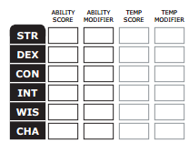
Generating Hero Ability Values
In most role-playing games, heroes have abilities such as strength, dexterity, intelligence, charism, etc.
Initial abilities are often measured in ranges like 3 – 18
At the beginning of the game, players roll dice to determine the initial values for each ability
The higher the value, the more likely the player will succeed while adventuring

Slide 4
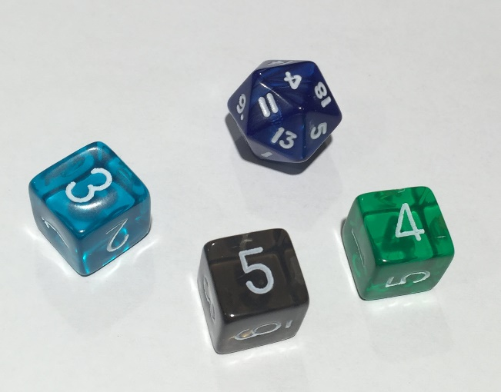
Generating Hero Ability Values
Two ways of rolling for initial abilities between 3 and 18
Roll a 20-sided die just once (1d20), but reroll if face value is 1, 2, 19, or 20
Roll a 6-sided die three times (3d6), summing the value of each roll
Using the 1d20 method is faster than 3d6, especially when having to roll for six separate abilities
17
11
15
5
7
3

Slide 5
Functions
You can declare and define your own custom functions
Function names use CamelCase #1 – the first letter is Capitalized
A function is essentially a custom scope (a group of statements)
Functions receive value via a parameter list
A function can get inbound values passed to it from somewhere else in the source code
Each parameter has a data type and variable identifier
Functions output a value via the return statement
A function can only return one intrinsic data type
The return statement is usually at the end of the function

Slide 6
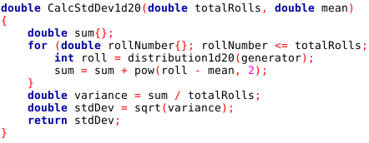
Defining a Function
Return Type
Function name
Inbound Parameter List
Functions open a scope
Functions close a scope
A function ends at return and sends the value back to the calling function

Slide 7
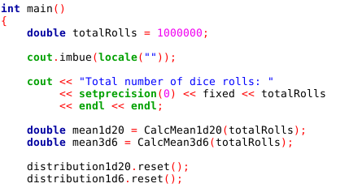
Calling a Function
Don’t need types in front of the parameters when calling a function
Return value stored in a local variable

Slide 8
Generating Hero Ability Values
Two ways of rolling for initial abilities between 3 and 18:
Roll a 20-sided die just once (1d20), but reroll if face value is 1, 2, 19, or 20
Roll a 6-sided die three times (3d6), summing the value of each roll
Which method would you want to use? Why?
17
11
15
5
7
3

Slide 9
Mean vs. Variance
Imagine two different classes take the same test
1st period students score between 50 and 100 with μ = 75
2nd period students score between 70 and 80 with μ = 75
Variance ${(σ}^{2})$ is the average “distance” between each number in a set and the mean $\left(μ\right)$ of that set
1st period students have a greater variance in scores than 2nd period
Variance is a measure of central tendency – on average how close around the mean do all the numbers fall?
For every data point, we sum the square of the difference between the number and the mean. Then we divide that sum by the total number of data points

Slide 10
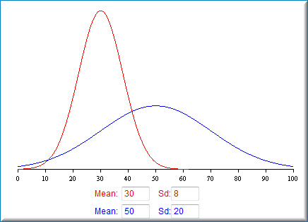
Mean vs. Standard Deviation
Note: Standard Deviation (σ) is the square root of the Variance (σ²)

Slide 11
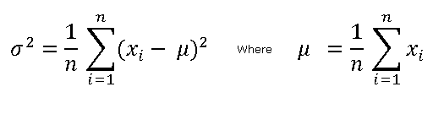
Mean, Variance, Standard Deviation
Mean

Slide 12
Mean, Variance, Standard Deviation
Mean
$$x=\left\{2, 9, 11, 5, 6\right\}∴n=5$$
$$\sum_{i=1}^{n}{x_{i}}=\left(2+9+11+5+6\right)=33$$
$$μ=\frac{33}{5}=6.6$$

Slide 13
Mean, Variance, Standard Deviation
Variance
Mean
$$x=\left\{2, 9, 11, 5, 6\right\}∴n=5, μ=6.6$$
$$\sum_{i=1}^{n}{{{(x}_{i}−μ)}^{2}}={(2−6.6)}^{2}+{(9−6.6)}^{2}+{(11−6.6)}^{2}+…=49.2$$
$$σ^{2}=\frac{49.2}{5}=9.84$$

Slide 14

Mean, Variance, Standard Deviation
Variance
Mean
$$x=\{2, 9, 11, 5, 6\}$$
Standard Deviation
$$σ^{2}=9.84$$
$$σ=\sqrt{9.84}≅3.13$$

Slide 15

Pseudorandom Numbers
We will all use 2016 to verify your code with mine
Generator initialized to seed
Emits random integers using a uniform distribution
Sets low & high range,
both inclusive

Slide 16
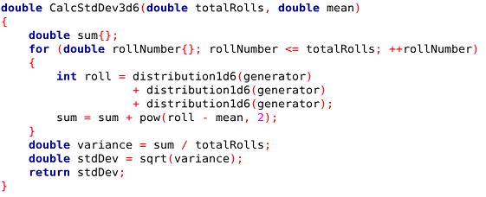
Pseudorandom Numbers
Calls the
distribution1d6()
function three times.
Each call moves the generator to the next state

Slide 17
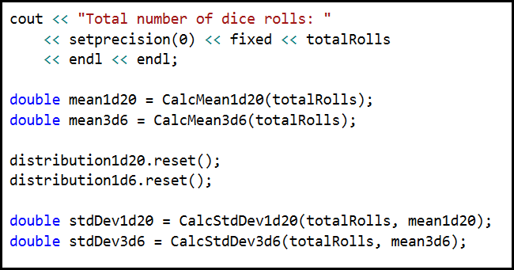
Pseudorandom Numbers
.reset() returns the distribution back to the original seed value

Slide 18
Open Lab 1 – Hero Abilities
Update a program to generate 1,000,000 hero ability scores, comparing the mean and standard deviation of the 1d20 versus the 3d6 dice roll methods
In particular, write the missing code to correctly calculate the CalcStdDev1d20 function
Use pow(x, y) to calculate $x^{y}$
Which dice roll method would you want to use to generate your hero’s abilities?

Slide 19
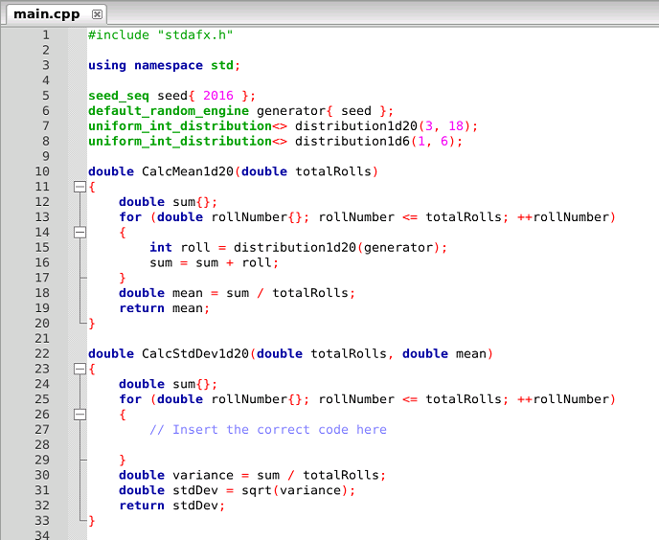

Edit Lab 1 – Hero Abilities

Slide 20
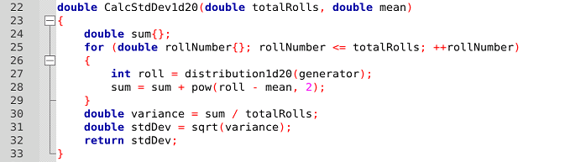
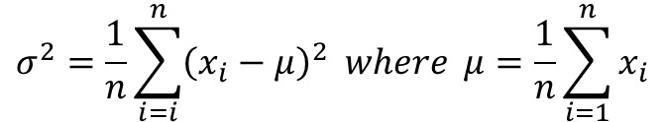
Edit Lab 1 – Hero Abilities
$$roll=x_{i}$$
$$totalRolls=n$$
$$mean=μ$$
$$sum=\sum{{(x_{i}−μ)}^{2}}$$
$$variance=\frac{sum}{n}=σ^{2}$$
$$stdDev=\sqrt{σ^{2}}$$
$$σ^{2}=\frac{1}{n}\sum_{i=i}^{n}{{\left(x_{i}−μ\right)}^{2} where μ=\frac{1}{n}\sum_{i=1}^{n}{x_{i}}}$$

Slide 21
Run Lab 1 – Hero Abilities

Slide 22
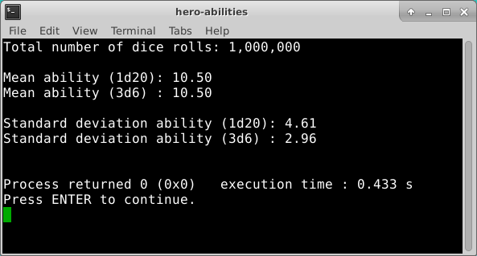
Check Lab 1 – Hero Abilities
Which roll type will most likely give you the highest average score across all abilities?

Slide 23
Variance of Uniform Distributions
Given an existing program that can:
Generate 15 sets of random size between 1 million & 2 million items
Within each set, every item is a random integer chosen within a range between a lower limit and an upper limit
The lower limit is a random number between 0 and 1000
The upper limit is 2x that set’s lower limit + another random number between 0 and 1000
Calculate the mean (μ) and variance (σ²) for each set
$$σ^{2}=\frac{1}{n}\sum_{i=i}^{n}{{\left(x_{i}−μ\right)}^{2} where μ=\frac{1}{n}\sum_{i=1}^{n}{x_{i}}}$$

Slide 24
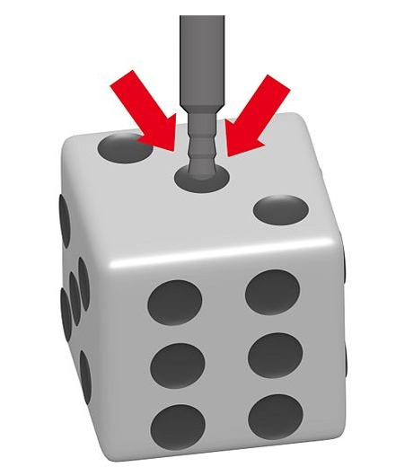
Variance of Uniform Distributions
Your assignment is to discover a magic number hidden in all uniform random number distributions
Calculate and display this “constant” for each set:
Is this number the same for ALL uniform distributions?
Can we use this value to test if dice are loaded?
magicNumber = $\frac{{(upperLimit − lowerLimit)}^{2}}{variance}$

Slide 25
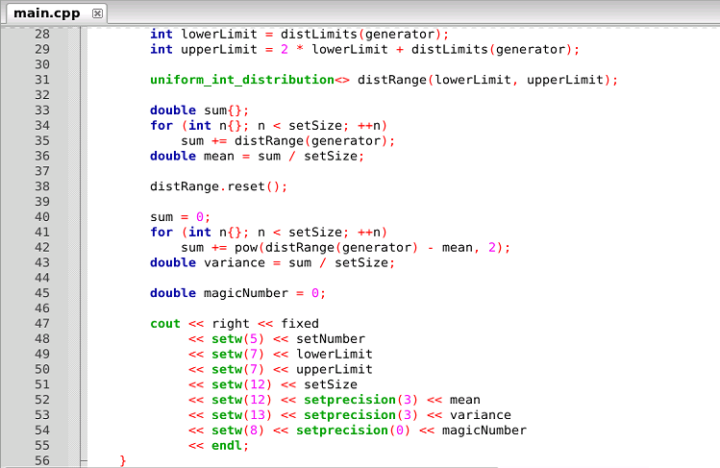
Edit Lab 2 – Variance of Uniform Distributions
Fix this formula

Slide 26
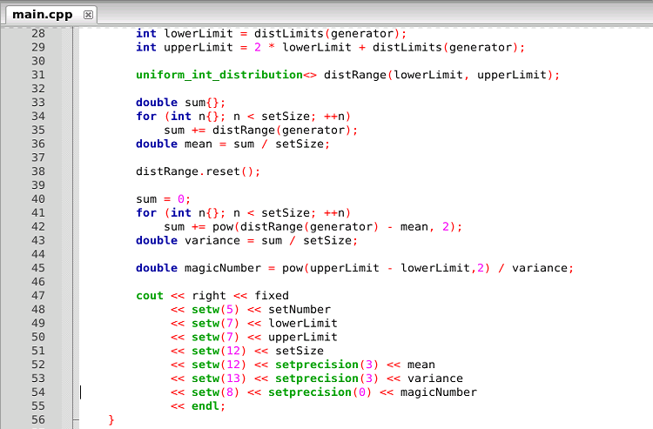
Run Lab 2 – Variance of Uniform Distributions

Slide 27
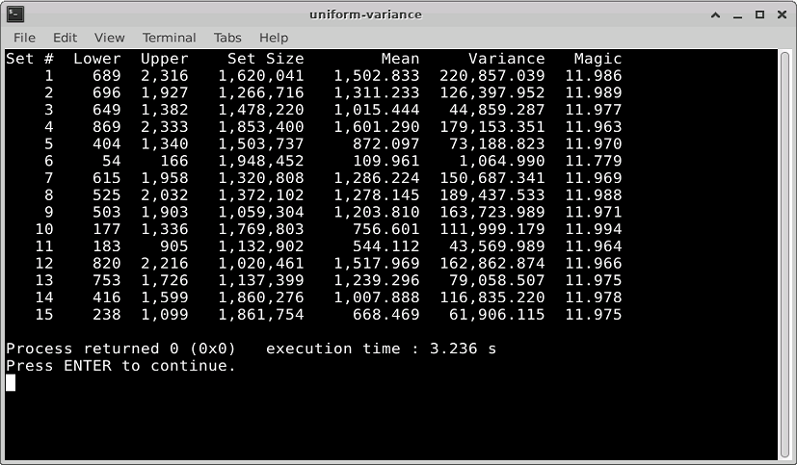
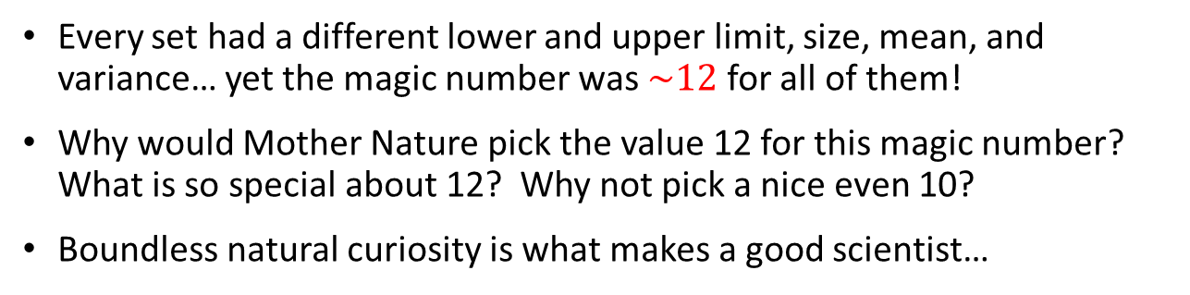
Check Lab 2 – Variance of Uniform Distributions
Every set had a different lower and upper limit, size, mean, and variance… yet the magic number was $\sim 12$ for all of them!
Why would Mother Nature pick the value 12 for this magic number? What is so special about 12? Why not pick a nice even 10?
Boundless natural curiosity is what makes a good scientist…

Slide 28

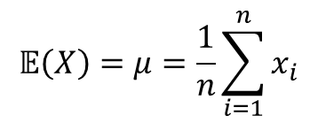
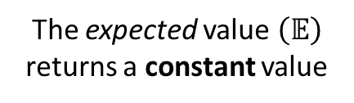

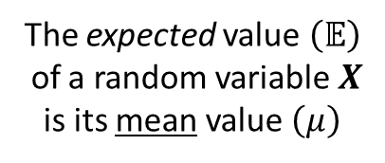
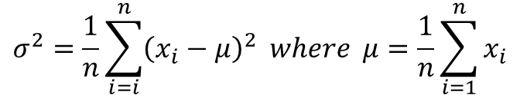


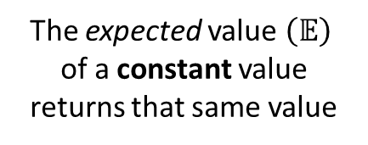
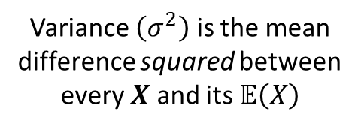

Variance of Uniform Distributions
$$σ^{2}=\frac{1}{n}\sum_{i=i}^{n}{{\left(x_{i}−μ\right)}^{2} where μ=\frac{1}{n}\sum_{i=1}^{n}{x_{i}}}$$
The expected value $\left(𝔼\right)$
of a random variable $X$ is its mean value $\left(μ\right)$
Variance $\left(σ^{2}\right)$ is the mean difference squared between every $X$ and its $𝔼\left(X\right)$
$$𝔼\left(X\right)=μ=\frac{1}{n}\sum_{i=1}^{n}{x_{i}}$$
$σ^{2}=𝔼$ $\left[{\left(X−𝔼\left(X\right)\right)}^{2}\right]$
The expected value $\left(𝔼\right)$
returns a constant value
$$𝔼\left(X\right)=μ$$
$$𝔼\left(𝔼\left(X\right)\right)=𝔼\left(X\right)$$
The expected value $\left(𝔼\right)$
of a constant value returns that same value
$$𝔼\left(𝔼\left(𝔼\left(X\right)\right)\right)=𝔼\left(X\right)$$
$$𝔼\left(μ\right)=μ$$

Slide 29











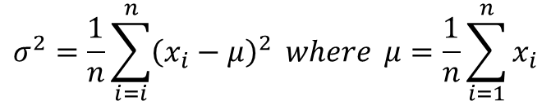

Variance of Uniform Distributions
$$σ^{2}=\frac{1}{n}\sum_{i=i}^{n}{{\left(x_{i}−μ\right)}^{2} where μ=\frac{1}{n}\sum_{i=1}^{n}{x_{i}}}$$
$$μ=𝔼\left(X\right)=\frac{1}{n}\sum_{i=1}^{n}{x_{i}}$$
$σ^{2}=𝔼$ $\left[{\left(X−𝔼\left(X\right)\right)}^{2}\right]$
FOIL
$$σ^{2}=𝔼\left[X^{2}−2X𝔼\left(X\right)+{𝔼\left(X\right)}^{2}\right]$$
$σ^{2}=𝔼$ $\left[{\left(X−𝔼\left(X\right)\right)}^{2}\right]$
Note: $𝔼\left(x\right)$ is a distributive liner operator
$$𝔼\left(μ\right)=μ$$
$$σ^{2}=𝔼\left(X^{2}\right)−𝔼\left(2X𝔼\left(X\right)\right)+𝔼\left({𝔼\left(X\right)}^{2}\right)$$
$$𝔼\left(𝔼\left(X\right)\right)=𝔼\left(X\right)$$
$$σ^{2}=𝔼\left(X^{2}\right)−2𝔼\left(X\right)𝔼\left(X\right)+{𝔼\left(X\right)}^{2}$$
Faster because
only one subtraction is required!
$$σ^{2}=\left(\frac{1}{n}\sum_{i=1}^{n}{x_{i}^{2}}\right)−μ^{2}$$
$$σ^{2}=𝔼\left(X^{2}\right)−2{𝔼\left(X\right)}^{2}+{𝔼\left(X\right)}^{2}$$
$$σ^{2}=𝔼\left(X^{2}\right)−{𝔼\left(X\right)}^{2}$$
$$σ^{2}=𝔼\left(X^{2}\right)−μ^{2}$$

Slide 30
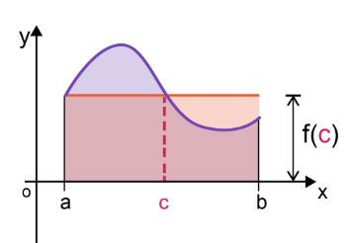
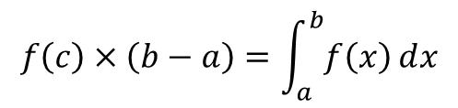

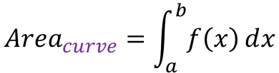


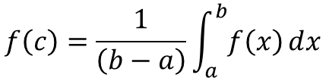
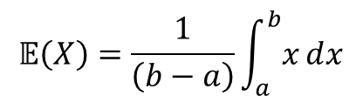

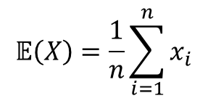
Variance of Uniform Distributions
$f\left(c\right)=$ the average value of the function
Mean Value Theorem (Integrals)
$${Area}_{red}={Area}_{curve}$$
$${Area}_{red}=f(c)×\left(b−a\right)$$
$${Area}_{curve}=\int_{a}^{b}{f\left(x\right)ⅆx}$$
$$f\left(c\right)×\left(b−a\right)=\int_{a}^{b}{f\left(x\right)ⅆx}$$
Random Variable (Uniform Distribution)
$$𝔼\left(X\right)=\frac{1}{n}\sum_{i=1}^{n}{x_{i}}$$
$$f\left(c\right)=\frac{1}{\left(b−a\right)}\int_{a}^{b}{f\left(x\right)ⅆx}$$
Discrete:
$$𝔼\left(X\right)=\frac{1}{\left(b−a\right)}\int_{a}^{b}{xⅆx}$$
$$f\left(c\right)=μ=𝔼\left(X\right)$$
Continuous:

Slide 31
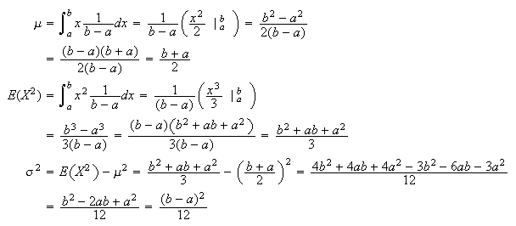

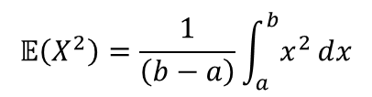
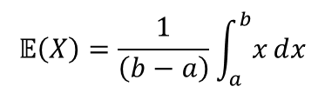


Variance of Uniform Distributions
$$𝔼\left(X\right)=\frac{1}{\left(b−a\right)}\int_{a}^{b}{xⅆx}$$
Moment Generating Function
$$𝔼\left(X^{2}\right)=\frac{1}{\left(b−a\right)}\int_{a}^{b}{x^{2}ⅆx}$$
$$σ^{2}=𝔼\left(X^{2}\right)−μ^{2}$$
$$\frac{\left(18+3\right)}{2}=10.5$$
Lab 1 Results

Slide 32
Variance of Uniform Distributions
$$𝔼\left(X\right)=\frac{1}{\left(b−a\right)}\int_{a}^{b}{xⅆx}$$
Moment Generating Function
$$𝔼\left(X^{2}\right)=\frac{1}{\left(b−a\right)}\int_{a}^{b}{x^{2}ⅆx}$$
$$σ^{2}=𝔼\left(X^{2}\right)−μ^{2}$$

Slide 33
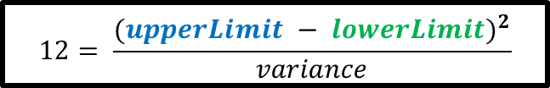
Variance of Uniform Distributions
$$𝔼\left(X\right)=\frac{1}{\left(b−a\right)}\int_{a}^{b}{xⅆx}$$
Moment Generating Function
$$𝔼\left(X^{2}\right)=\frac{1}{\left(b−a\right)}\int_{a}^{b}{x^{2}ⅆx}$$
$$σ^{2}=𝔼\left(X^{2}\right)−μ^{2}$$
$$12= \frac{{(upperLimit − lowerLimit)}^{2}}{variance}$$

Slide 34
Understanding Probability
The probability of a continuous random variable having an exact value is zero!!
We can never measure continuous distributions exactly
The measurement changes as we increase magnification/precision
Accumulating statistics may enable accurate trend prediction
Single events may happen in a non-deterministic manner
Yet the aggregate ensemble behavior might be deterministic
A paradox? Think Lotto: small odds for all, yet someone always wins
Scientific observables are governed by averages
Statistical Mechanics: temperate = average kinetic energy
Quantum Mechanics: Shape of electron orbitals

Slide 35
What Should Students Learn?
The Probability and Statistics Used Most Often at BNL:
Uniform, Normal, Exponential, Logarithmic
Student’s t
Bernoulli, Binomial, Beta
Poisson, Erlang, Pareto
Mean, Mode, Median
Skew, Variance, Std. Dev
Moments of Distribution
Conditional Probability
Bayesian Inference
Gamma, Chi-Squared
Maxwell-Boltzman
Regression Techniques
Confidence Intervals
Hypothesis Testing
Time Series Analysis
ANOVA
Stochastic Processes
Markov Chains
Clustering Algorithms

Slide 36

Random Straws
Write a program to perform ten million runs of an experiment that places a varying number of straws end-to-end each run
In each run, start with a single straw of random length between 0 < n < 1
Then enter a loop that keeps adding additional straws of random length (0 < n < 1) until the total length is > 1
Find the mean number of straws added before the total length > 1, across all ten million runs of the experiment

Slide 37
Random Straws
0.63
1.0
0.89
Straws
0.13
0.89
0.63
1
0.13
0.45
2
0.13
0.76
Run # 1
3
1.21
1
0.13
Run # 2
2
1.02
0.13
0.76
1
0.13
0.07
0.25
2
0.13
0.20
Run # 3
0.07
3
0.13
0.25
0.45
0.07
4
1.21

Slide 38
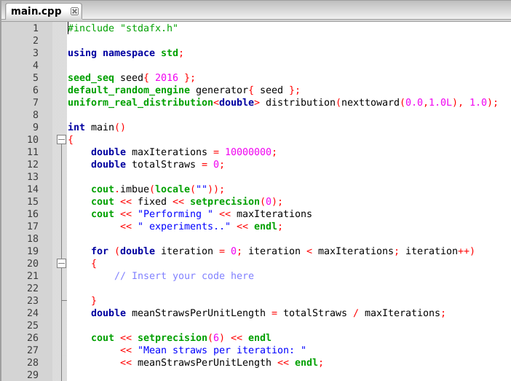

Edit Lab 3 – Random Straws
$$\left[a,\left.b\right)\right.→0≤x<1$$
BAD! We cannot draw a zero-length straw from the bag!

Slide 39

Edit Lab 3 – Random Straws
$$\left[a,\left.b\right)\right.→4.940656e-324≤x<1$$

Slide 40

Edit Lab 3 – Random Straws
$$\left(a,b\right)→0<x<1$$
Write code to perform each step of the experiment

Slide 41
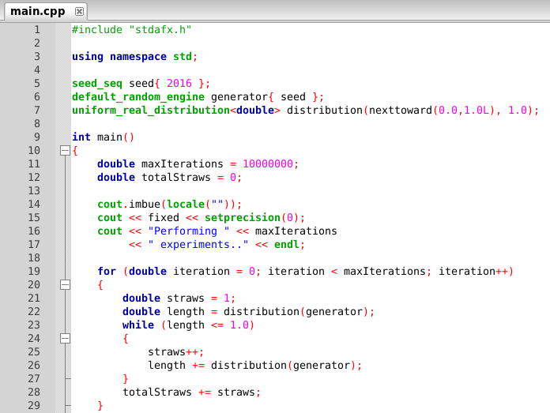
Run Lab 3 – Random Straws

Slide 42
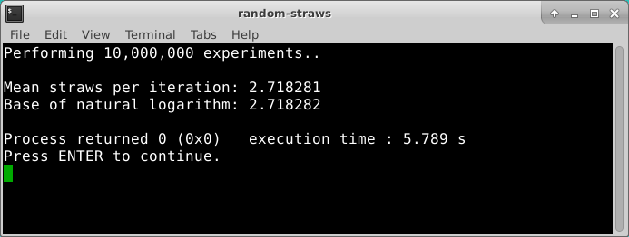
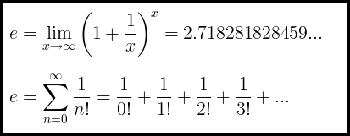
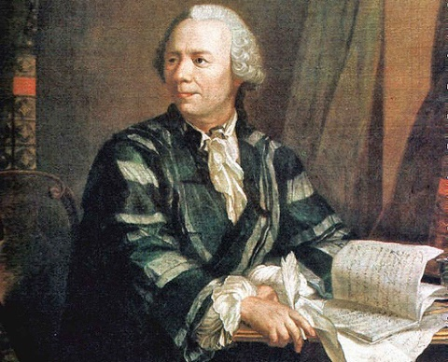
Check Lab 3 – Random Straws

Slide 43
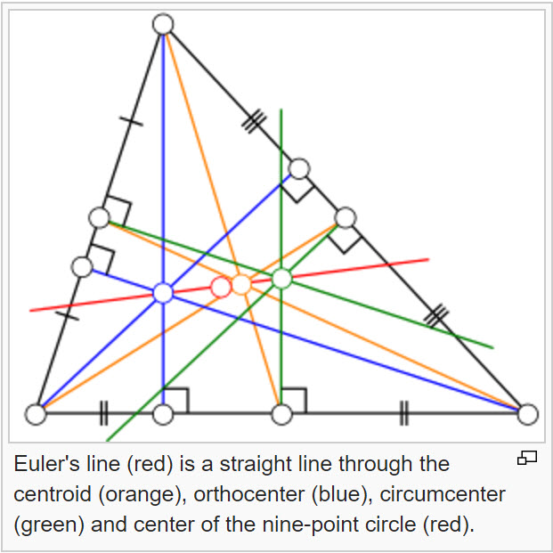
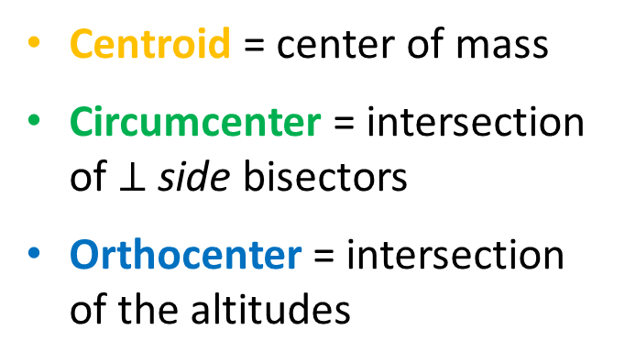
A Geometry Gem the Greeks Overlooked
Centroid = center of mass
Circumcenter = intersection of $⊥$ side bisectors
Orthocenter = intersection of the altitudes
The
Euler Line
Euler was the first to realize and prove those three points are always colinear for any given triangle!

Slide 44
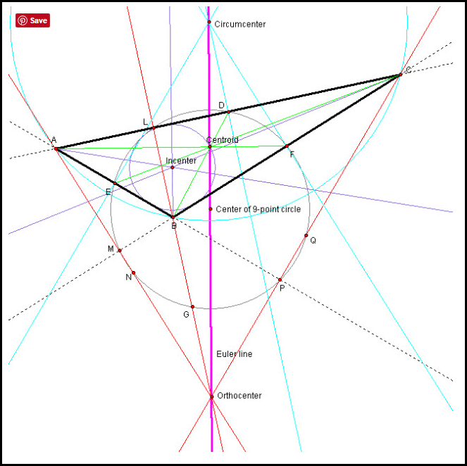
The Euler Line

Slide 45

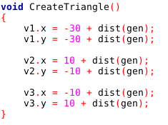
The Euler Line
(30, 30)
v3
(20)
(-10,10)
v2
(0,0)
(10,-10)
(20)
(20)
v1
(-30,-30)

Slide 46

Open Lab 4 – Euler Line
Press the N key to draw a new random triangle

Slide 47



View Lab 4 – Euler Line
Note: This code only draws the line connecting the centroid and circumcenter

Slide 48


Run Lab 4 – Euler Line
Press the N key to draw a new random triangle

Slide 49


Check Lab 4 – Euler Line
Left click & drag to draw a zoom rectangle

Slide 50
Edit Lab 4 – Euler Line
Recall Euler proved the orthocenter (the intersection of the altitudes) is also on that same red line
The orthocenter is similar to the circumcenter, except instead of using the midpoint of each side, we use the vertex opposite each side, to find the point-slope form of each altitude
Use v1 and the negative reciprocal of slope v2v3
Use v2 and the negative reciprocal of slope v1v3
Add code to Lab 4 to calculate and draw the orthocenter, to visually confirm it falls on the same line formed from the centroid and circumcenter – for all triangles!

Slide 51
Now you know…
How to calculate Mean, Variance, Standard Deviation
Variance is just another average: it is the average distance between each data point and the mean$μ$of the entire set
Create and call custom functions to organize code into named scopes having specific purposes
A seemingly random process hides a different universal constant: $e$
Some statistics are only meaningful after generating a very large sample set – everything in scientific computing is big

